Slide 1
K-Means Cluster

Slide 2
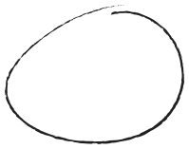

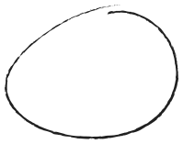

K - Mean Cluster
K-Means Clustering is an Unsupervised Machine Learning algorithm which
groups unlabeled dataset into different clusters.It is used to organize data into groups based on their similarity.
Example
Tall
Medium
Short

Slide 3



We don't know before hand which student belongs to which group — We just have the height values.
That’s where K-Means comes in!
Tall
Step - 1
Medium
Step 1:Choose K (Number of clusters)
We decide how many clusters you want. Example: Let’s say K = 3 (short, medium, tall groups)
Short

Slide 4
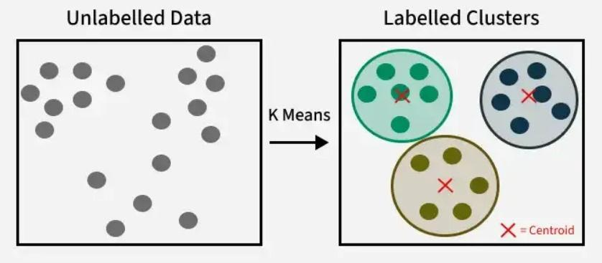
Step - 2
Step2: Randomly pick K points as Centroids
Pick 3 random heights as initial "centroids" (one for each group). These are the starting center points of the clusters.
Tall
Medium
Short

Slide 5
Step - 3
Step3: Assign each data point to the closest centroid
For each student (height), calculate the distance to all 3 centroids. Assign them to the closest group.
Now you’ve formed 3 groups (clusters).
Tall
Medium
Step - 4
Step 4: Recalculate the centroids Find the average height of all students in each group. These averages become the new centroids.
Short

Slide 6
Step - 5
Repeat Steps 3 and 4
Reassign students based on the new centroids. Then recalculate centroids again.
➡ Repeat this until the centroids stop changing or change very little (i.e., the model converges).

